Slide 2
Scope
Adeline must narrow from the double diode to the single diode. https://www.pveducation.org/pvcdrom/characterisation/double-diode-model
From 5 parameters to 3 parameters
Finally to the fitting of the 3 parameters with lambert W
Next coming to the trust region and levenberg method.

Slide 3
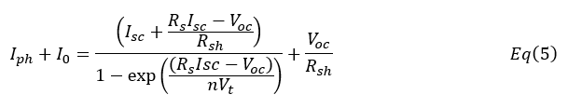




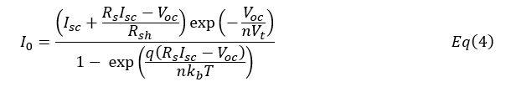

Theory
Express Iph and I0 in terms of Voc, Isc, Rs,Rsh and n
Solve equation 1 for I = - Isc and V = 0
A very useful approximation can be made if the following condition is true
Solve equation 1 for I = 0 and V = Voc
Combine equation 2 and 3 to obtain equation 4 and 5
Then equation 5 can be rewritten as

Slide 5
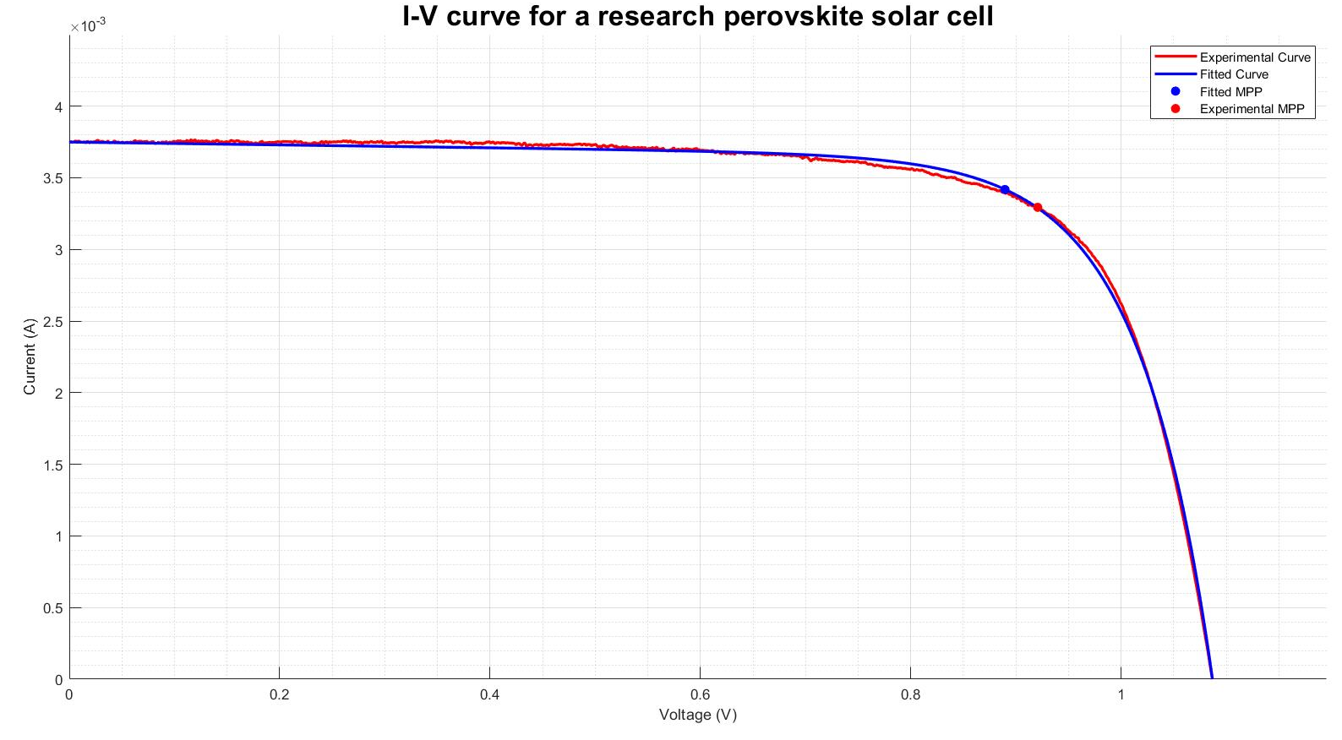
What is the problem?
Extracted Parameters
Rs (Ω) | Rsh (kΩ) | n
-1.28 | 10.00 | 2.88

Slide 6
Problem Statement
Current models for characterization are not reliable enough for high throughput characterization
Negative parameters
Initial guesses in literature are not applicable for all I-V data curves
Too far from the actual solution
Undefined at initial guess
Non realistic parameters extracted
Solutions to these problems mean
More reliable parameter
Help understand the issue causing low fill factor

Slide 7
A possible solution
Use trust region method
Applying constraints to the possible parameters
Constraints derived from assuming one parameter influences the shape of the curve

Slide 8
Objectives
Investigate the ability to extract accurate and sensible Rs,Rsh and n for different IV data

Slide 9
Simulate IV data
Specify the following
Voc
Isc
Introduce noise with signal to noise ratio (SR) of 45
Generate evenly spaced voltage data from 0V to (1.1*Voc)V.
Generate current with explicit single diode equation.
Rs
Rsh
n

Slide 10
Simulated cases
Case | Rs (Ω) | Rsh (kΩ) | n
1 | 0.10 | 1.00E+03 | 1.00
2 | 25.00 | 1.00E+03 | 1.00
3 | 0.10 | 0.20 | 1.00
4 | 0.10 | 1.00E+03 | 2.50
5 | 25.00 | 1.00E+03 | 2.50
6 | 0.10 | 0.2 | 2.50
7 | 0.10 | 1.00E+03 | 5.00
8 | 25.00 | 0.2 | 5.00
Specify the following
Voc = 1 V
Isc = 20 mA
Rs = case(i,2)
Rsh = case(i,3)
n = case(i,4)

Slide 11
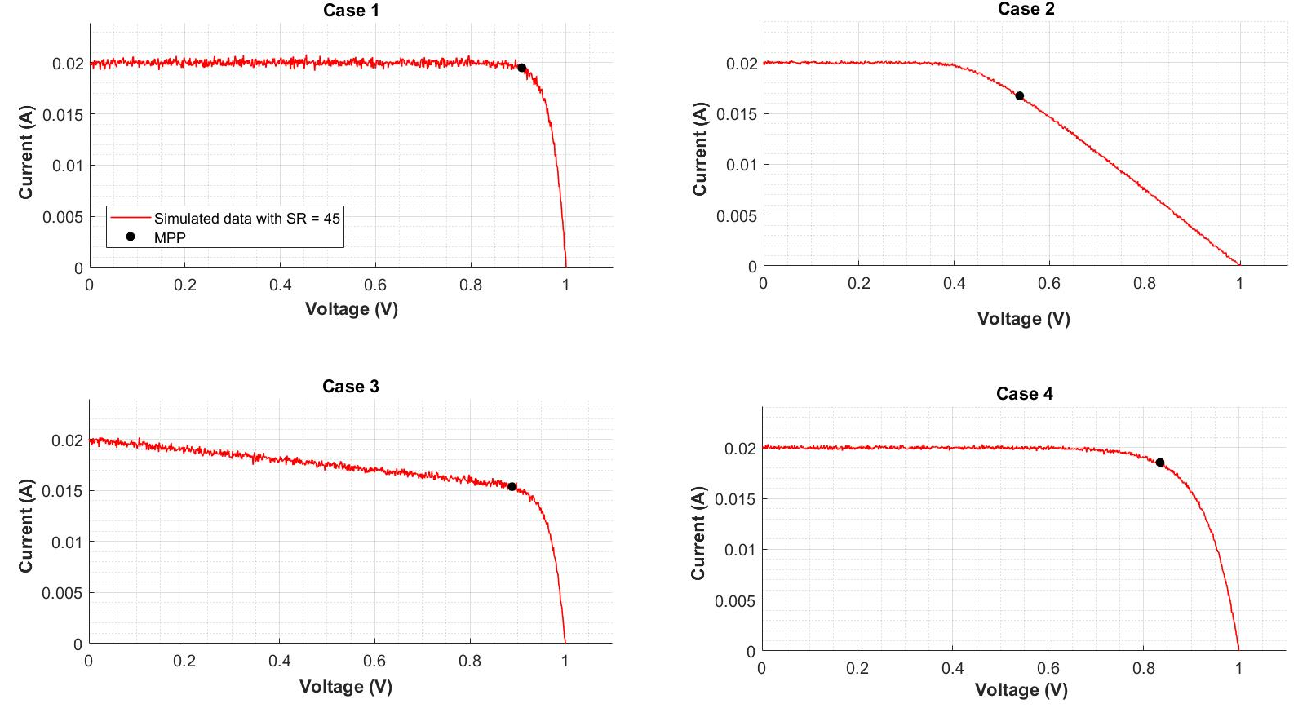
Simulated cases 1 - 4

Slide 12
Simulated cases 5 - 8

Slide 13
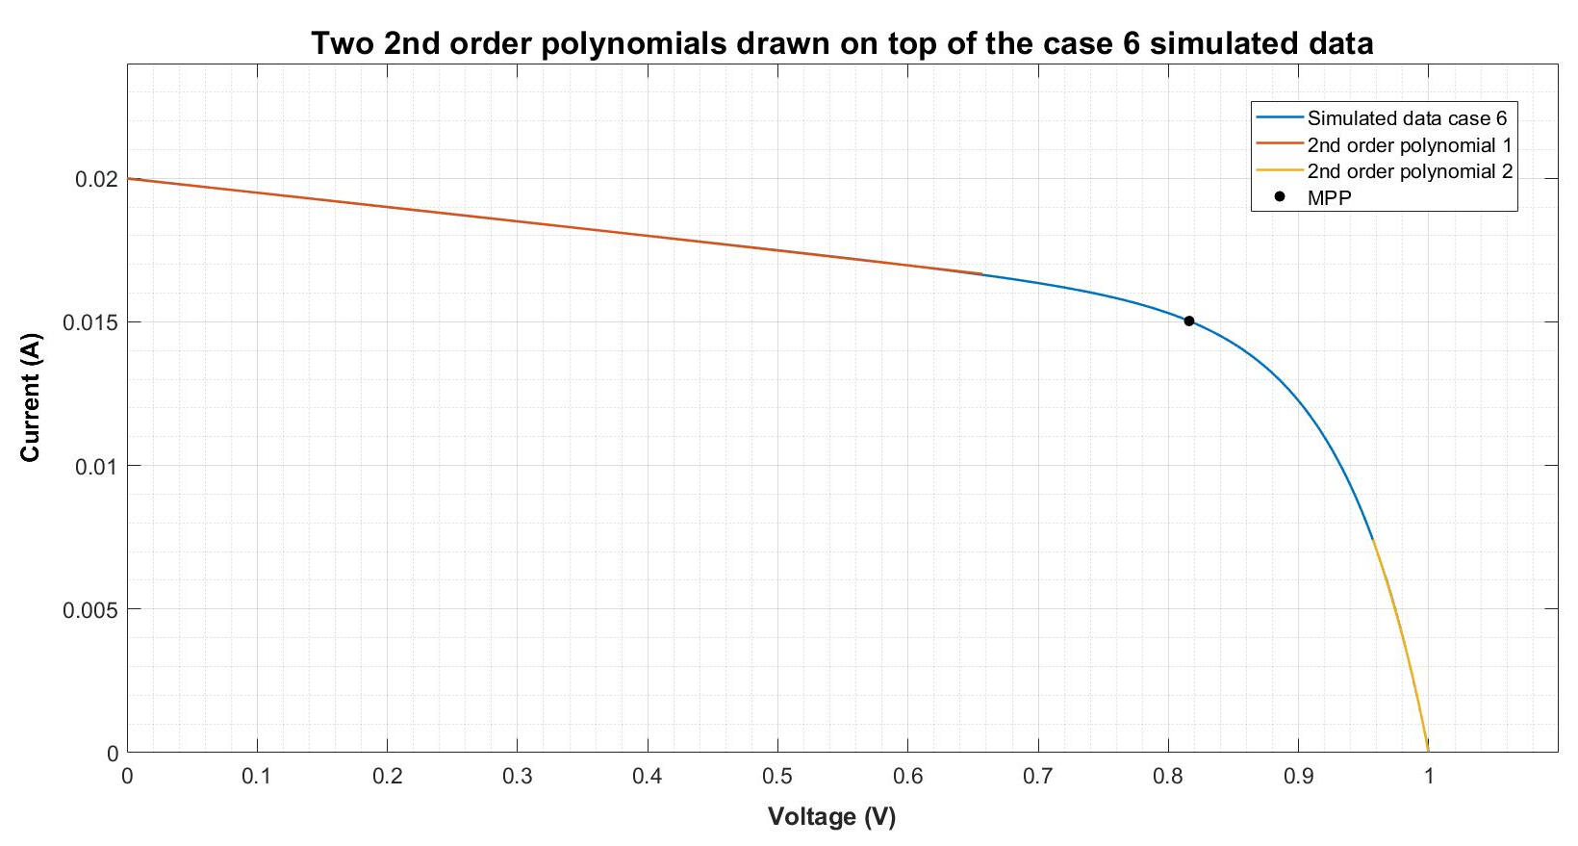


Parameter extraction: Gradients at V = 0 and V = Voc
1) Smooth current data
2) Find Voc and Isc from data
3) Find Vm and Im
4) Fit data with two 2nd order polynomials
5) Differentiate 2nd order polynomial
6) Evaluate polynomials at I = 0 and Isc

Slide 15

Constraint Methodology
n
Maximum
Assume Rs = 0 and Rsh = Inf
Then equation can be simplified to
Minimum
n = 1

Slide 16
Parameter extraction: Solver Step
Use matlab built in ‘lsqnonlin’ function
Algorithm - trust region method
Tolerances = 1*10^-10
Least squares data in the active quadrant
Constraint the possible solutions of Rs,Rsh and n

